Slide 1
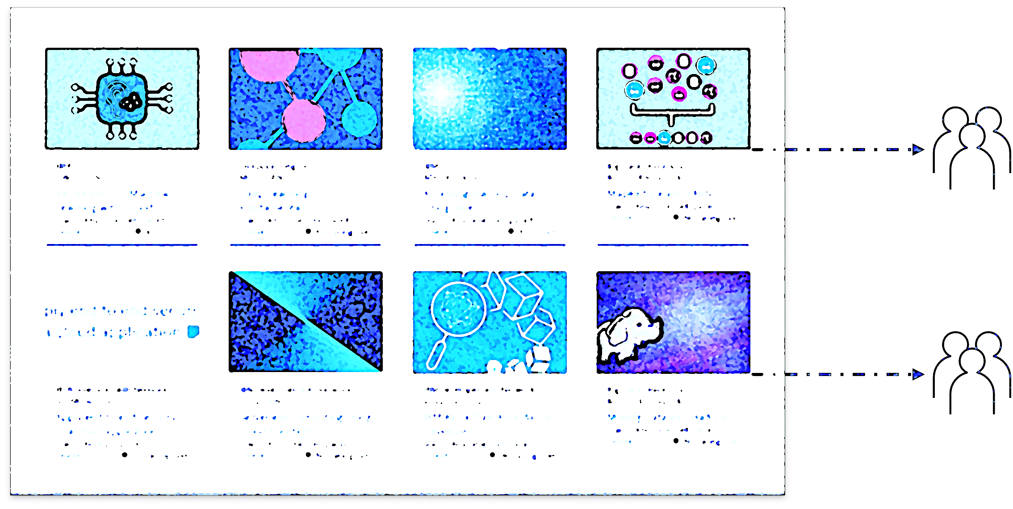
Building a Personalised
Online Course Recommender System
with Machine Learning Technologies
Dan Stollenwerk
24/1/24

Slide 2
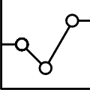

Outline
Introduction
Exploratory Data Analysis
Content-Based Recommender System > Unsupervised Learning
Collaborative Filtering-Based Recommender System > Supervised Learning
Observations
Appendix

Slide 3
Introduction
An online course recommender system enhances personalised learning experiences by suggesting relevant courses based on user preferences as reflected by past activity
Promotes continuous skill development
Improves user reach of educational resources
Problem: test machine learning technologies using online course data to build optimised recommender system
Hypothesis: implementation of recommender system will improve completion rate of online courses

Slide 4
Exploratory Data Analysis

Slide 5
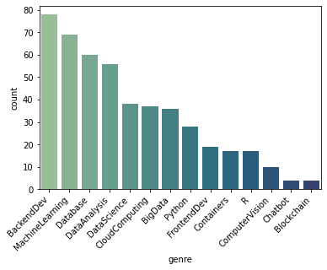
Course Genre Distribution
BackendDev most common genre with 78 relevant courses
Chatbot and Blockchain least common genres with only 4 relevant courses

Slide 6
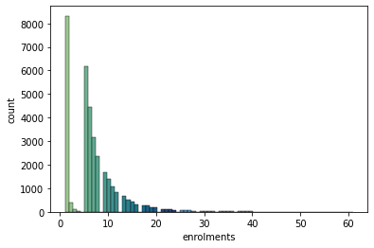
Course Enrolments Distribution
Largest group of users (8,320 / 33,901: 24.5%) enrolled in only 1 course
Next-largest group of users (6,179 / 33,901: 18.2%) enrolled in 5 courses
Data observes exponential decay
Some enrolment numbers held by ~0 users
These numbers appear at regular intervals of 4 bars – why?

Slide 7
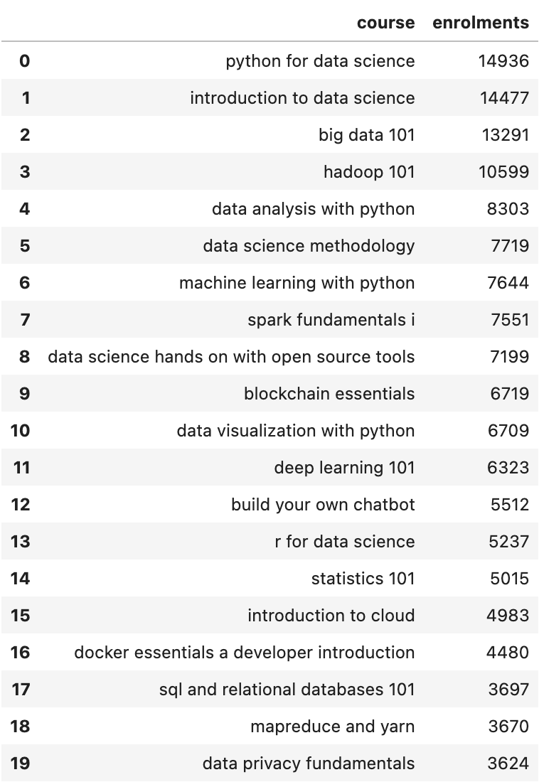
Top 20 Courses
Python for Data Science #1 with 14,936 enrolments
4 of top 10 courses Python-related
10 of top 20 courses marketed to beginner learners (course title containing terms introduction, 101, fundamentals or essentials)

Slide 8
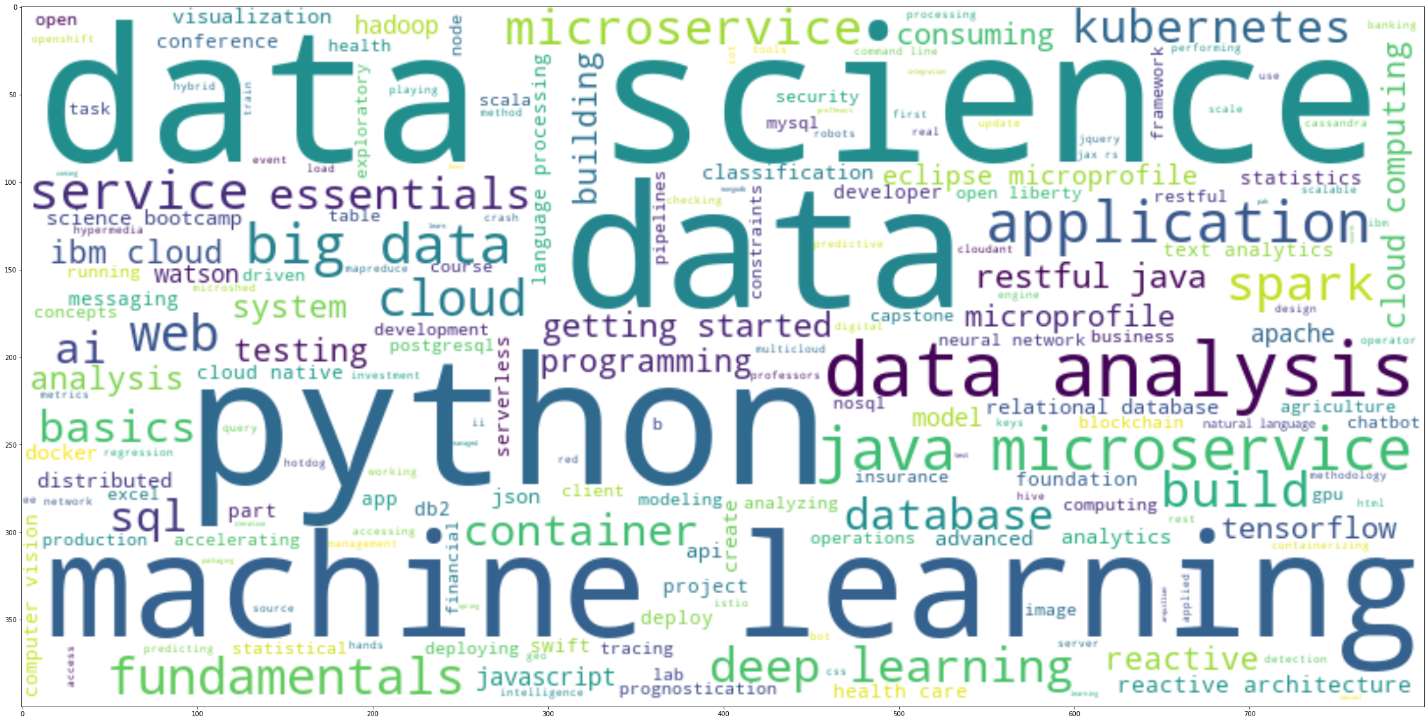
Word Cloud of Course Titles
Terms appearing most frequently in online course descriptions dataset
Top terms include data (science/analysis), python and machine learning

Slide 9
Content-Based Recommender System > Unsupervised Learning
cluster 2
cluster 1

Slide 10
Content-Based Recommender System Flowchart (user profile, course genres)
USER PROFILE VECTOR
COMPUTE DOT PRODUCT
RECOMMEND-ATION SCORES
CHECK AGAINST THRESHOLD
COURSE GENRE MATRIX
ADD COURSE TO LIST IF SCORE > THRESHOLD & NOT ALR. ENROLLED
RECOMMENDED COURSES LIST

Slide 11
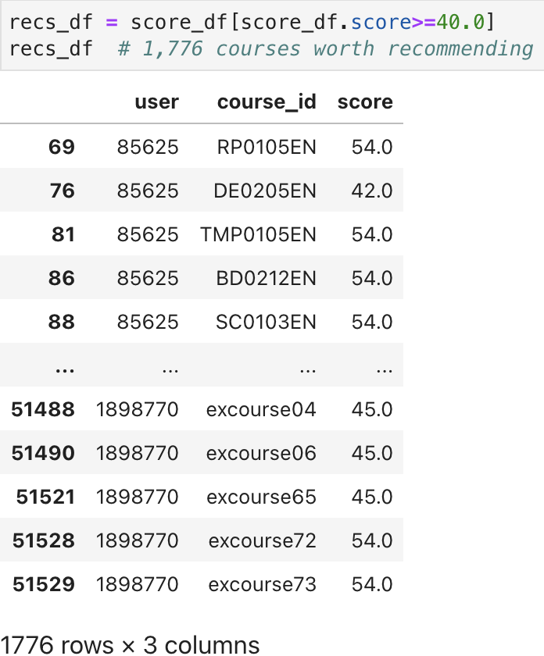
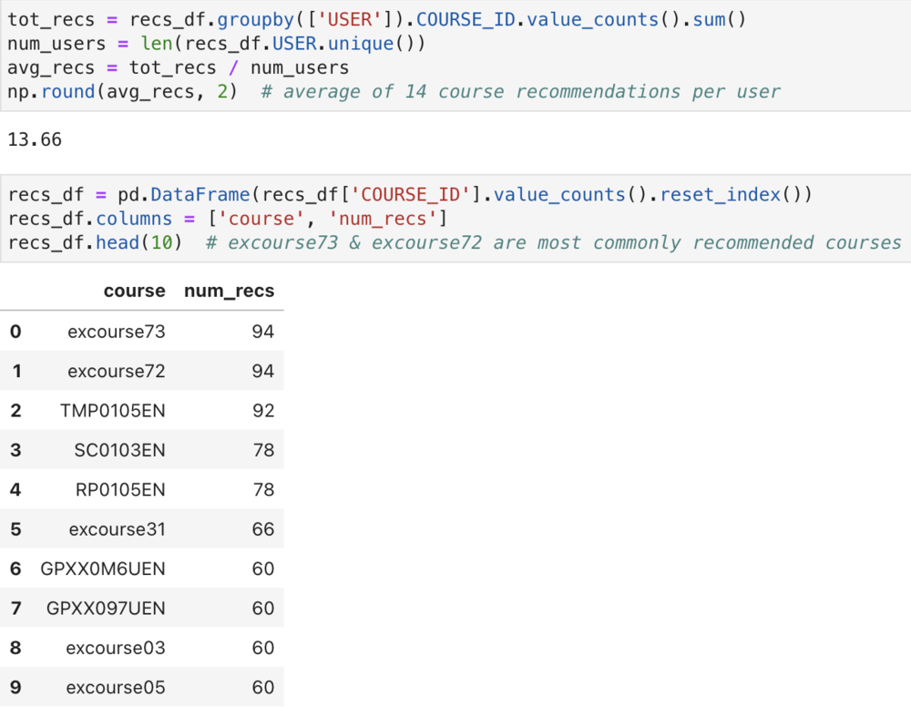
User Profile-Based Recommender System Evaluation Results
Notes:
Course recommendation score threshold: 40.0
Average course recommendations per user: 14
Most commonly recommended courses: excourse73 & excourse72

Slide 12
Content-Based Recommender System Flowchart (course similarity)
ENROLLED COURSES
COURSE SIMILARITY MATRIX
FIND MATRIX ENTRY w/ INDEX
SIMILARITY SCORES
CHECK AGAINST THRESHOLD
UNSELECTED COURSES
ADD COURSE TO LIST IF SCORE > THRESHOLD
RECOMMENDED COURSES LIST
Notes:
Explain chart here

Slide 13
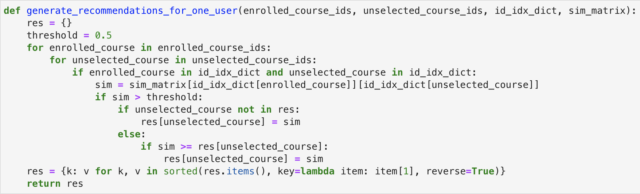
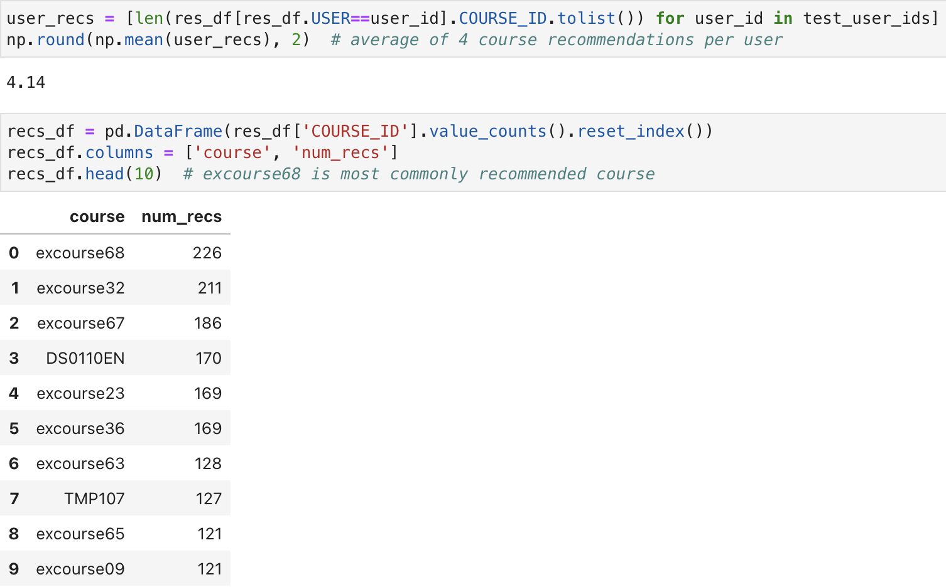
Course Similarity-Based Recommender System Evaluation Results
Notes:
Course similarity score threshold: 0.5
Average course recommendations per user: 4
Most commonly recommended course: excourse68

Slide 14
Clustering-Based Recommender System Flowchart
NORMALISED USER PROFILE VECTORS
PCA DIM. RED. ALGORITHM
CLUSTER LABELS
GET TOP COURSES PER CLUSTER
TOP COURSES
PRINCIPAL COMPONENTS
RECOMMENDED COURSES LIST
ADD COURSE TO LIST IF NOT ALR. ENROLLED
K-MEANS CLUSTER ALGORITHM

Slide 15
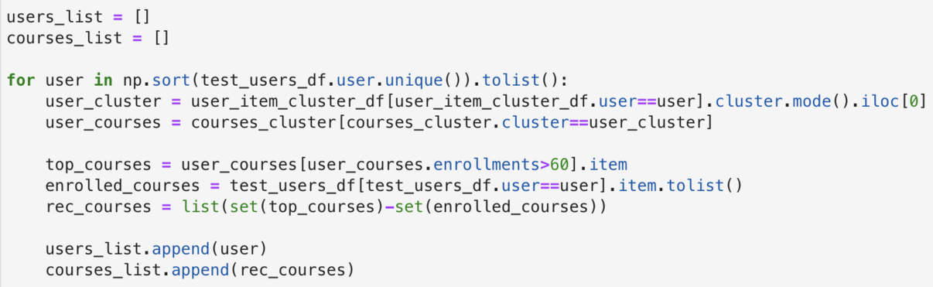
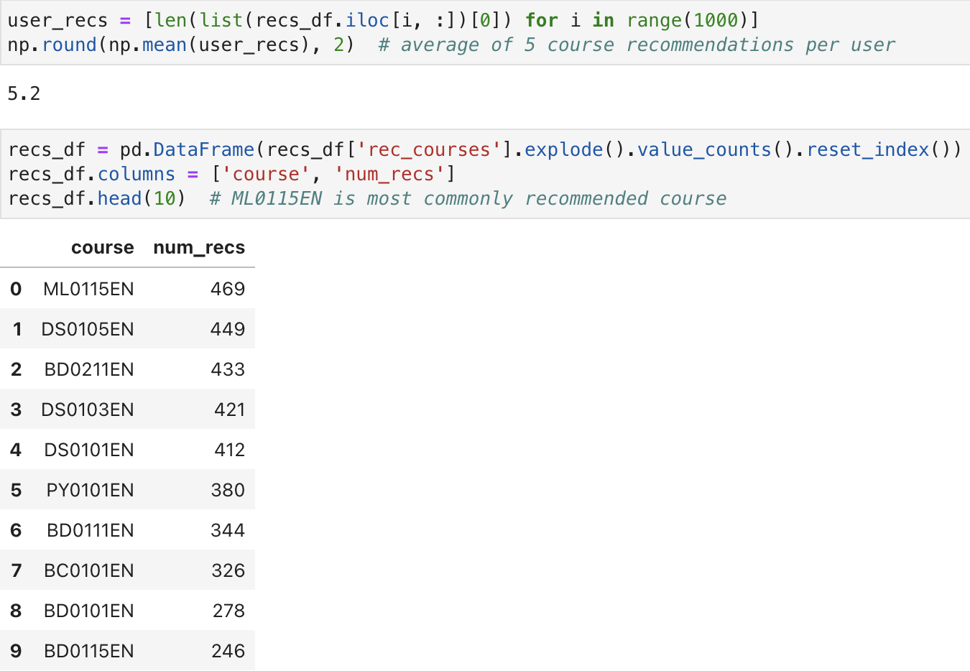
Clustering-Based Recommender System Evaluation Results
Notes:
Course enrolments threshold: 60
Average course recommendations per user: 5
Most recommended course: ML0155EN

Slide 16
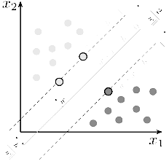
Collaborative Filtering- Based Recommender System > Supervised Learning
x2
x1

Slide 17
KNN-Based Recommender System Flowchart
USER-ITEM INTERACTION MATRIX
TRAIN_TEST_-SPLIT FUNCTION
PREDICT RATINGS FOR TEST DATA
ADD COURSE TO LIST IF RATING ≥ 2.5
RATING PREDICTIONS
TRAIN SET & TEST SET
FIT MODEL TO TRAIN DATA
RECOMMENDED COURSES LIST
KNNBASIC MODEL
ROOT MEAN SQUARED ERROR
RMSE SCORE

Slide 18
NMF-Based Recommender System Flowchart
USER-ITEM INTERACTION MATRIX
TRAIN_TEST_-SPLIT FUNCTION
PREDICT RATINGS FOR TEST DATA
USER MATRIX & ITEM MATRIX
FIT MODEL TO TRAIN DATA
RATING PREDICTIONS
ADD COURSE TO LIST IF RATING ≥ 2.5
TRAIN SET & TEST SET
NMF MODEL
RECOMMENDED COURSES LIST
ROOT MEAN SQUARED ERROR
RMSE SCORE

Slide 19
Neural Network Embedding-Based Recommender System Flowchart
REGRESSION
CLASSIFICATION
USER-ITEM INTERACTION MATRIX
PASS THROUGH NN EMBEDDING LAYER
INTERACTION EMBED. MATRIX
ENCODE LABELS
RECOMMENDED COURSES LIST
CATEGORICAL INTERACTION EMBED. MATRIX
USER EMBED. & ITEM EMBED.
ELEMENT-WISE ADDITION
ADD COURSE TO LIST IF RATING ≥ 2.5
SUPPORT VECTOR CLASSIFIER
LINEAR REGRESSOR
TRAIN_TEST_-SPLIT FUNCTION
RATING PREDICTIONS
PREDICT RATINGS FOR TEST DATA
FIT MODEL TO TRAIN DATA
TRAIN SET & TEST SET
ROOT MEAN SQUARED ERROR
RMSE SCORE

Slide 20
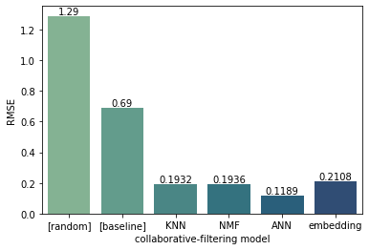
Performance of Collaborative Filtering Models Compared
Artificial neural network (ANN) model performed best with RMSE score of 0.1189
Scores of models tested all lie within 0.1 range
Overall performance more evenly distributed than expected
Linear regression model fit to neural network embedding
Support vector machine classification model also performed well with 98.4% accuracy, 99.7% recall, 98.7% precision and F1 score of 0.9926

Slide 21
Observations
User profile-based recommender system most liberal with ~14 course recommendations per user
Course similarity- and clustering-based systems discriminate relevant courses from rest more strictly, making ~4 and ~5 recommendations respectively
Recommended courses vary greatly from model to model
No course recommended by all 3 content-based systems
User profile- and course similarity-based systems generate similar recommendations, clustering-based system noticeably different
Former systems push course category excourse (5 and 8 recommendations in top 10 respectively), latter does not (0 in top 10)
Checks out – former are similar methodologically (supervised learning; rows of database are users, columns are courses), latter is different (unsupervised learning)
Diminishing returns on RecommenderNet ANN model train and validation loss after 2nd epoch (see FIGURE →)
~600,000-parameter model potentially overfit; can be regularised and optimised

Slide 22
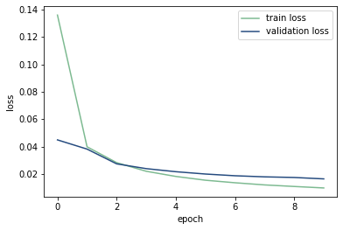
Appendix
FIGURE
All Machine Learning Capstone labs accessible here

Slide 23
github.com/danswk /ibm/tree/main/ml-capstone

